Slide 1

Working With Data DATA9910
Week 4
Lucas Rizzo
email: lucas.rizzo@tudublin.ie

Slide 2
Indicative schedule
Week 1 | Set up environment and R notebook
Week 2 | Review Python and practice
Week 3 | Review R Importing data with R
Week 4 | Intro SQL and aggregate queries
Week 5 | Databases and scripting languages (To be submitted)
Week 6 | Interpreting Data (summary statistics, data visualisation)
Week 7 | Review week
Week 8 | Data manipulation in R Pandas and Numpy
Week 9 | Data visualisation in Python Data processing (regular expressions)
Week 10 | Audio data (R and tuneR) (To be submitted)
Week 11 | Image data (Python and skimage) (To be submitted)
Week 12 | Time series (Python and Pandas)
Week 13 | Working on Assignment Assignment deadline

Slide 3
Overview
Database refresher
Tables, columns, keys
SQL databases and R dataframes
Data modification language
Basic data definition language
Relationships
Aggregate queries

Slide 4

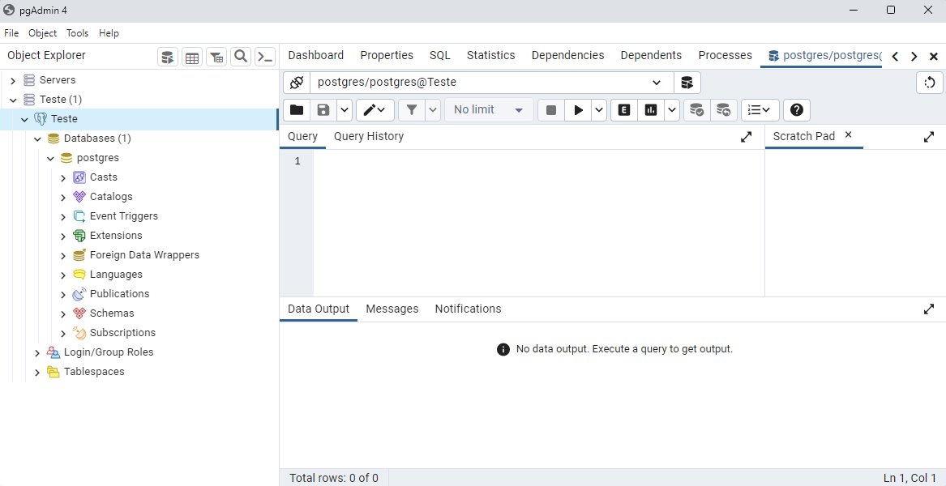
PostgreSQL set up
You can download PostgreSQL here https://www.postgresql.org/download/
Open the pgAdmin tool. This is the administration and management tools for the PostgreSQL database.

Slide 5
SQL Databases and R DataFrames
An R Dataframe is a like a lightweight SQL table
A dataframe consists of:
columns (with a type) which define the dataframe
rows, or values, which make up the data
Dataframes are often flat, we tend to have wide dataframes containing all the columns we need in a single place
R dataframes usually only live for as long as the R session

Slide 6
SQL Databases and R DataFrames
An SQL table is heavily optimized and more complex than a R dataframe
Like R dataframes, SQL tables consist of strongly typed columns and rows
Databases are usually normalized. We tend to have one table per thing (entity) and we join those tables together when we query SQL tables live on the hard drive; they are persistent.

Slide 7
ERD
SQL databases depend on the structure of entities and the pattern of relationships between them.
It is designed to avoid data redundancy and increase data integrity.
An Entity Relationship Diagram (ERD) lets you see how different entities relate to each other in an application or a database
It is implementation independent

Slide 8
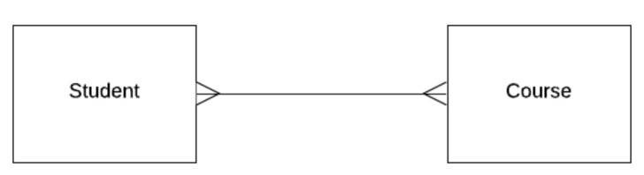
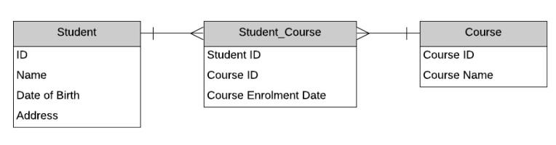
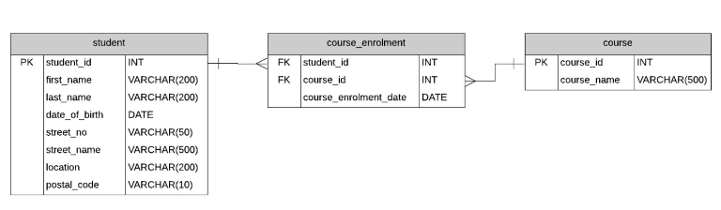
Different types of ERD
Conceptual model
Logical model
A physical model
Examples of notation and models can be seen here
https://www.databasestar.com/entity-relationship-diagram/

Slide 9
Why Structured?
SQL enforces strict data structures
All items in a collection have the same set of properties
Each item’s properties have the same type
Missing values must be explicitly allowed

Slide 10
Flavours of SQL
SQL is actually a family of closely related languages
SQL has a standard of the American National Standards Institute (ANSI), although implementations don’t follow it fully.
Oracle SQL
SELECT * FROM
Students
ORDER BY dob
FETCH FIRST 10
ROWS ONLY;
MS SQL
SELECT TOP 10 *
FROM Students
ORDER BY dob;
PostgreSQL
SELECT * FROM
Students
ORDER BY dob
LIMIT 10;

Slide 11
Data Types
Python
Float
Integer
Boolean
String
Datetime module
Pandas categorical data type
NA
SQL
NUMERIC(precision,
scale)
INT
BOOLEAN
CHAR(Size),VARCHAR (Size), TEXT
DATE
Foreign Key (kind of, by using a table of categories)
NULL
R
Double
Integer
Boolean
Character
Date
Factor
NA

Slide 12
SQL Number
In SQL, you must specify exactly how much space you want to use to store a number
Precision is the number of digits in a number
Scale is the number of those digits to the right of the decimal place.

Slide 13
SQL Number
What precision and scale would you use for…
A random number seed which is a whole number 8 digits long?
Price of stock less than €1000?
A number between 0 and 1, to 5 decimal places?
A boolean column?

Slide 14
SQL Number
What precision and scale would you use for…
A random number seed which is a whole number 8 digits long? (8,0)
Price of stock less than €1000? (5,2)
A number between 0 and 1, to 5 decimal places? (6,5)
A boolean column? (1,0)

Slide 15
VARCHAR
Strings are represented in a database using the VARCHAR type
The varchar size specifies the maximum number of characters allowed
CREATE TABLE Customer (
FirstName VARCHAR (50)
);
String literals must be written using single quotes
SELECT * FROM Customer WHERE FirstName = 'Lucas'

Slide 16
DATE
We can add date information to a column using the DATE datatype
We can specify dates as a string and PostgreSQL will automatically parse them
It’s better to use the TO_DATE() function and specify our format manually
SELECT * FROM Orders WHERE OrderDate > '01-Nov-20'
SELECT * FROM Orders WHERE OrderDate > TO_DATE('2020-11-01','YYYY-MM-DD')

Slide 17
NULL
The value NA in R corresponds to PostgreSQL NULL value
R always allows NA values in a dataframe, but in SQL columns must explicitly forbid them
CREATE TABLE contacts(
id INT,
first_name VARCHAR(50) NOT NULL,
last_name VARCHAR(50) NOT NULL,
email VARCHAR(255) NOT NULL,
phone VARCHAR(15),
PRIMARY KEY (id)
);

Slide 18
Primary Key
Each table in SQL should have a primary key
A primary key is a column (or group of columns) which uniquely identify the row
Primary keys can be actual features of the entity (i.e. a student number), or an auto-generated value (i.e. ID)
Technically, a primary key constraint is the combination of a not-null constraint and a UNIQUE constraint.

Slide 19
Primary Key
CREATE TABLE po_headers (
po_no INTEGER PRIMARY KEY,
vendor_no INTEGER,
description TEXT,
shipping_address TEXT
);
CREATE TABLE po_items (
po_no INTEGER,
item_no INTEGER,
product_no INTEGER,
PRIMARY KEY (po_no, item_no)
);

Slide 20
Selecting Data
To retrieve data from our tables we use the SELECT command
SELECT col1, col2, col3 FROM Table
We can use * as a shortcut to select all columns

Slide 21
Selecting and Ordering Data
We can sort results in SQL using the ORDER BY clause
This will sort results by a given column(s) in ascending order by default
The DESC keyword reverses the default order
The ORDER BY clause always comes last in a statement
SELECT * FROM Customer
ORDER BY FirstName, LastName;
SELECT * FROM Customer
ORDER BY LastLoginDate DESC;

Slide 22
Filtering Data
We can use a WHERE clause to filter the data we retrieve
SELECT email FROM Customer WHERE marketingOptIn = 1

Slide 23
Filtering Data
The WHERE clause can be combined with AND, OR, and NOT operators.
PostgreSQL lets us use some basic wildcard matching on varchars using LIKE
The % symbol is equivalent to .* in a RegEx (match any number of characters)
The _ symbol is equivalent to . in a RegEx (match a single character)

Slide 24
Filtering Data
SELECT * FROM Customers WHERE Name = 'Lucas' AND Surname = 'Rizzo'
SELECT * FROM Customers WHERE Name LIKE '%ca%' OR Name LIKE 'L%s'
SELECT * FROM Customers WHERE Name LIKE 'L___s'

Slide 25
Inserting Data
We use an INSERT statement to add data to our tables
INSERT INTO Customer (id, firstName, lastName, marketingOptIn)
VALUES (1123, 'Lucas', 'Rizzo', 0);

Slide 26
Updating Data
We can change the values in a database using an UPDATE statement
UPDATE Customer SET marketingOptIn = 0 WHERE marketingOptIn IS NULL

Slide 27
Deleting Data
We can delete values in a database using a DELETE statement
DELETE FROM Customer WHERE id = 1123

Slide 28
Dropping Tables
To permanently remove a table from the database we use the DROP command
DROP TABLE Customer

Slide 29
Altering Tables
We can change the definition of a table using the ALTER TABLE command
ALTER TABLE Customer ADD dob DATE NULL;

Slide 30
Foreign Key
Tables in a relational databases are related to each other
Every order in a sales database was placed by a customer
We can say that order belongs to the customer
We can represent this using a foreign key

Slide 31
Creating Tables
Suppose we want to model a very basic version of IMDB where we store information about movies and actors
We’ll start with two tables
Movie
Actor

Slide 32
Creating Tables
First, we need to think about what columns we’ll need for movie

Slide 33
Creating Tables
First, we need to think about what columns we’ll need for movie
movieTitle, Year, Director, Budget, Profit

Slide 34
Creating Tables
First, we need to think about what columns we’ll need for movie
movieTitle, Year, Director, Budget, Profit
Next, what are the datatypes for those columns?
movieTitle
Year
Director
Budget
Profit

Slide 35
Creating Tables
First, we need to think about what columns we’ll need for movie
movieTitle, Year, Director, Budget, Profit
Next, what are the datatypes for those columns?
movieTitle VARCHAR(100)
Year DATE
Director VARCHAR(100)
Budget Numeric(12, 2)
Profit Numeric(12, 2)

Slide 36
Creating Tables
First, we need to think about what columns we’ll need for movie
movieTitle, Year, Director, Budget, Profit
Next, what are the datatypes for those columns?
movieTitle VARCHAR(100)
Year DATE
Director VARCHAR(100)
Budget Numeric(12, 2)
Profit Numeric(12, 2)
Are we missing anything?

Slide 37
Creating Tables
First, we need to think about what columns we’ll need for movie
movieTitle, Year, Director, Budget, Profit
Next, what are the datatypes for those columns?
movieTitle VARCHAR(100)
Year DATE
Director VARCHAR(100)
Budget Numeric(12, 2)
Profit Numeric(12, 2)
Are we missing anything?
movieId Numeric(4)

Slide 38
Creating Tables
What about Actor? Which attributes can we define?

Slide 39
Creating Tables
What about Actor? Which attributes can we define?
ActorID Numeric(4)
ActorName VARCHAR(100)

Slide 40
Creating tables
CREATE TABLE Movie(
movieID NUMERIC(4),
movieTitle VARCHAR(50),
year NUMERIC(4),
director VARCHAR(50),
budget NUMERIC(12,2),
profit NUMERIC(12,2),
PRIMARY KEY (movieID)
);

Slide 41
Creating tables
CREATE TABLE Actor(
actorID NUMERIC(4),
actorName VARCHAR(100),
PRIMARY KEY (actorID)
);

Slide 42
Relationships
We now have a table to store movies and a table to store actors
How do we store information about which actors acted in each movie?

Slide 43
Relationships
Title: Jumanji: Welcome to the Jungle
Year: 2017
Director: Jake Kasdan
Budget: 90 million
Profit: 962,077,546
Some Cast Members:
Dwayne Johnson -> Spencer
Kevin Hart -> Fridge
Jack Black -> Bethany

Slide 44
Relationships
Suppose we include the movieID and name of the character played on the ACTOR table.
ALTER TABLE Actor ADD COLUMN movieID NUMERIC(4), character VARCHAR(100);

Slide 45
Relationships
Our primary key is now not unique
Same actor can appear in multiple movies

Slide 46
Relationships
Suppose we include the actorID and name of the character played on the Movie table.
ALTER TABLE Movie ADD COLUMN actorID NUMERIC(4), character VARCHAR(100);

Slide 47
Relationships
Our primary key is now not unique.
We would have multiple rows of data for each movie (one for each actor who appeared in the movie.
The solution?

Slide 48
Relationships
Our primary key is now not unique.
We would have multiple rows of data for each movie (one for each actor who appeared in the movie.
The solution?
Add another table, Movie_Cast, containing actorID, movieID and roleName

Slide 49
Relationships
CREATE TABLE Movie_Cast(
actorID NUMERIC(4),
movieID NUMERIC(4),
roleplayed VARCHAR(50)
);
What should the primary key be?

Slide 50
Relationships
CREATE TABLE Movie_Cast(
actorID NUMERIC(4),
movieID NUMERIC(4),
roleplayed VARCHAR(50),
PRIMARY KEY (movieID, actorID, roleplayed)
);
The Cast table has a compound primary key

Slide 51
Foreign Keys
What happens to the Movie_Cast table if we remove an actor/movie from the Movie/Actor tables?

Slide 52
Foreign Keys
What happens to the Movie_Cast table if we remove an actor/movie from the Movie/Actor tables?
In order to improve data integrity we should define an explicitly relationship between our Cast table and Movie/Actor tables.
A foreign key can be defined for that.
A column of one table that is the same as the primary key of another

Slide 53
Foreign Keys
CREATE TABLE Movie_Cast(
movieID NUMERIC(4),
actorID NUMERIC(4),
rolePlayed VARCHAR (50),
CONSTRAINT cast_actor_fk FOREIGN KEY (actorID)
REFERENCES actor(actorID),
CONSTRAINT cast_movie_fk FOREIGN KEY (movieID)
REFERENCES movie(movieID),
PRIMARY KEY (movieID,actorID,rolePlayed)
);

Slide 54
Foreign Key
A foreign key links one table to another.
An attribute column should depend only on the key of the table, not on another attribute column.
Customer ID | First name | Last name
1 2 3 | Lucas Frodo Bilbo | Rizzo Baggins Baggins
Order ID | Item | Qty | Customer ID
ORD003 ORD005 | Smoking pipe Lembas bread | 2 1 | 3 2

Slide 55
Foreign Key
A foreign key links one table to another.
An attribute column should depend only on the key of the table, not on another attribute column.
Customer ID | First name | Last name
1 2 3 | Lucas Frodo Bilbo | Rizzo Baggins Baggins
Order ID | Item | Qty | Customer ID
ORD003 ORD005 | Smoking pipe Lembas bread | 2 1 | 3 2

Slide 56
Foreign Key
A foreign key links one table to another.
An attribute column should depend only on the key of the table, not on another attribute column.
Customer ID | First name | Last name
1 2 3 | Lucas Frodo Bilbo | Rizzo Baggins Baggins
Order ID | Item | Qty | Customer ID
ORD003 ORD005 | Smoking pipe Lembas bread | 2 1 | 3 2

Slide 57

Foreign Key
We can use foreign keys to join tables
SELECT c.CustomerID, o.OrderID, c.FirstName, o.Item, o.Qty
FROM Customers c
INNER JOIN Orders o
ON c.CustomerID = o.CustomerID

Slide 58
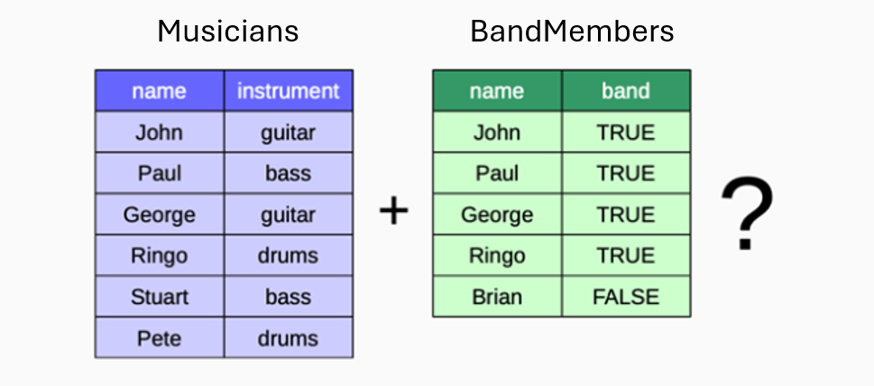
Joining Tables
We will use this example to explore the different ways to join tables

Slide 59
Toy Example
The code below will create these dataframes
-- Create the table
CREATE TABLE Musicians (
Name VARCHAR(50) PRIMARY KEY,
Instrument VARCHAR(50)
);
-- Insert data into the table
INSERT INTO Musicians (Name, Instrument) VALUES
('John', 'guitar'),
('Paul', 'bass'),
('George', 'guitar'),
('Ringo', 'drums'),
('Stuart', 'bass'),
('Pete', 'drums');
-- Create the table
CREATE TABLE BandMembers (
Name VARCHAR(50) PRIMARY KEY,
Band BOOLEAN
);
-- Insert data into the table
INSERT INTO BandMembers (Name, Band) VALUES
('John', TRUE),
('Paul', TRUE),
('George', TRUE),
('Ringo', TRUE),
('Brian', FALSE);

Slide 60
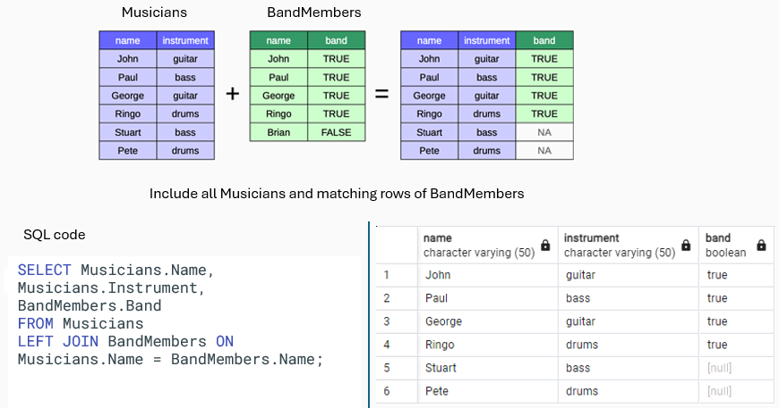
Left Join

Slide 61
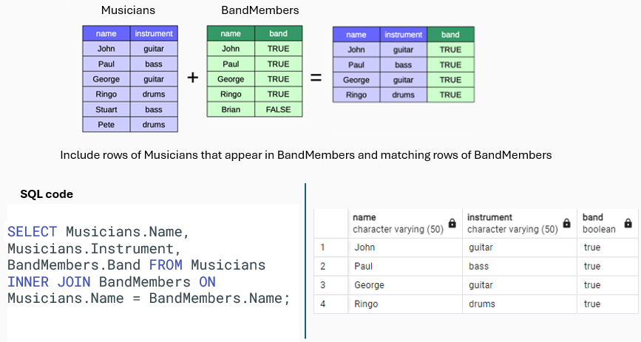
Inner Join

Slide 62
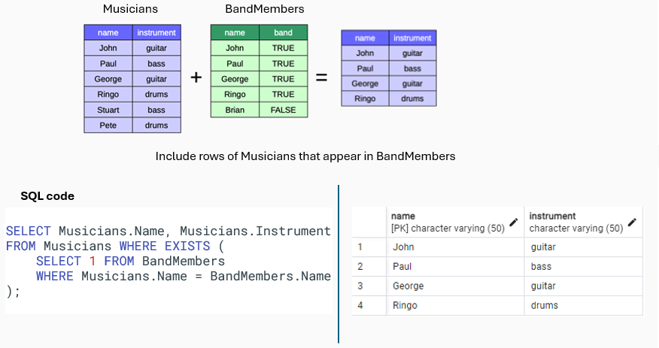
Semi-Join

Slide 63
Semi-Join
No semi-join keyword

Slide 64
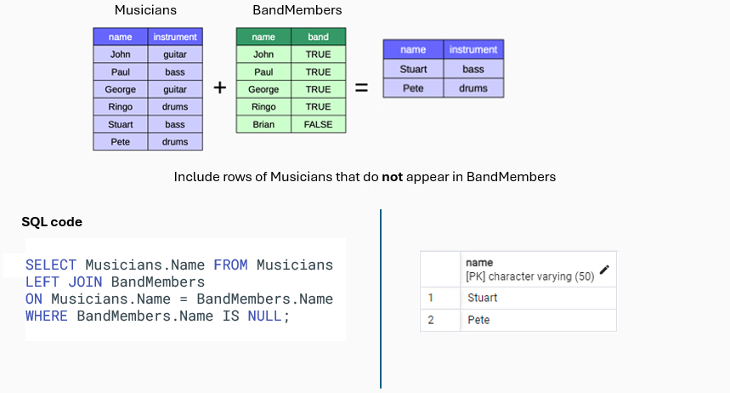
Anti-Join

Slide 65
Anti-Join
No anti-join keyword

Slide 66
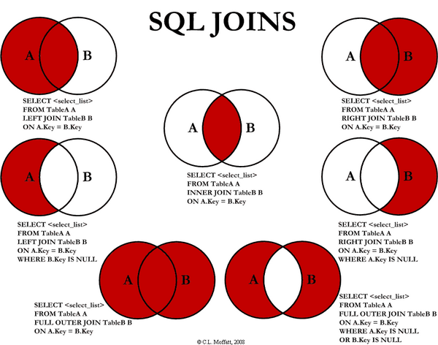
All joins cheat sheet
https://www.codeproject.com/Articles/33052/Visual-Representation-of-SQL-Joins

Slide 67
Aggregate Queries

Slide 68
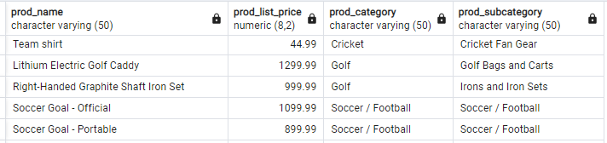
Aggregate Queries
What is the level of detail of the result?
SELECT p.prod_name, p.prod_list_price, p.prod_category, p.prod_subcategory
FROM products p
ORDER BY prod_category, prod_subcategory;

Slide 69
Aggregate Queries
How many rows does this return?
SELECT AVG(prod_list_price)
FROM products;

Slide 70

Aggregate Queries
How many rows does this return?
SELECT AVG(prod_list_price)
FROM products;
Much lower level of detail

Slide 71
Aggregate Queries
Pseudocode
Add up a running total of the value of prod_list_price in each row
Divide by the number of rows
Output the answer as a single row with a single column
SELECT AVG(prod_list_price)
FROM products;

Slide 72
Aggregate Queries
SUM, COUNT, AVG, STDDEV are aggregate functions
An aggregate function takes multiple numerical values as input and outputs a single numerical value
In databases, multiple numerical values are supplied as multiple rows in a query

Slide 73
Aggregate Queries
What is the average list price for each sub-category of products?
What is the level of detail of the resulting query?

Slide 74
Aggregate Queries
Pseudocode
For each row, check the value of PROD_SUBCATEGORY
Create a new bucket (a unit of storage) for each distinct value
In each bucket, initialize a counter for average price at 0.00
Add the value of PROD_LIST_PRICE to its bucket’s counter
For each bucket, divide the running total by the total number of rows
Output one row for each bucket
Level of detail is at the level of PROD_SUBCATEGORY

Slide 75
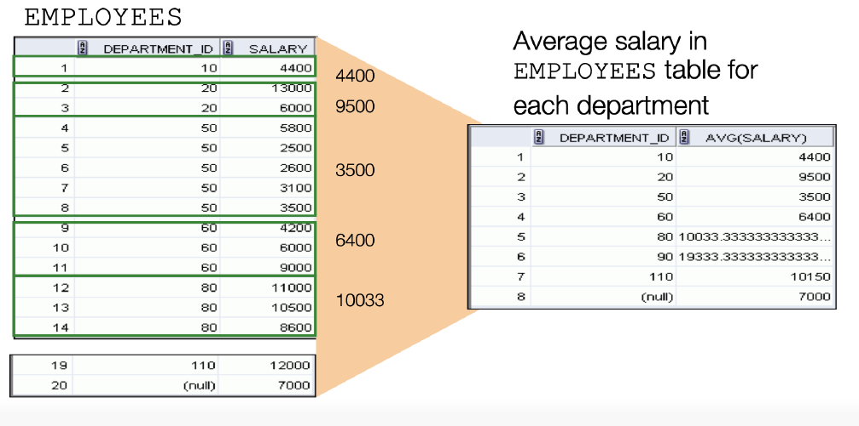
Aggregate Queries

Slide 76
Group By
By default, using any aggregate query will reduce our output table to a single row
If we want to change the level of detail we need to tell the database how to create its buckets using the GROUP BY statement
SELECT prord_subcategory, AVG(prod_list_price)
FROM products
GROUP BY prod_subcategory
ORDER BY prod_subcategory;

Slide 77
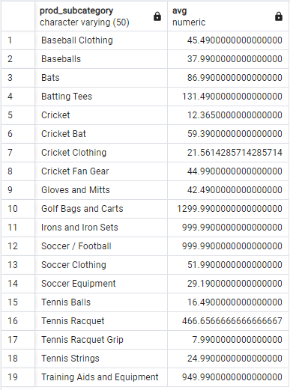
Group By
SELECT prod_subcategory, AVG(prod_list_price)
FROM products
GROUP BY prod_subcategory
ORDER BY prod_subcategory;

Slide 78
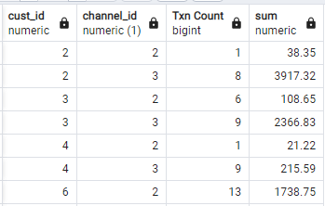
Group By
If we use multiple columns in GROUP BY statement we get one row for each unique combination
SELECT cust_id, channel_id, COUNT(*) "Txn Count", SUM(amount_sold)
FROM sales
GROUP BY cust_id, channel_id
ORDER BY cust_id, channel_id;

Slide 79
Group By
What is the problem?
SELECT cust_id, channel_desc, COUNT(*) "Txn Count", SUM(amount_sold)
FROM sales s
INNER JOIN channels c on s.channel_id = c.channel_id
GROUP BY cust_id
ORDER BY channel_desc;

Slide 80
Group By
What is the problem?
SELECT cust_id, channel_desc, COUNT(*) "Txn Count", SUM(amount_sold)
FROM sales s
INNER JOIN channels c on s.channel_id = c.channel_id
GROUP BY cust_id
ORDER BY channel_desc;
ERROR: column "c.channel_desc" must appear in the GROUP BY clause or be used in an aggregate function LINE 1: SELECT cust_id, channel_desc, COUNT(*) "Txn Count", SUM(amou…
SQL state: 42803 Character: 17Query returned successfully in 572 msec.

Slide 81
Group By
If you use any aggregate functions in your query then every column you select must
Be an aggregate function or
Appear in the GROUP BY clause
This ensures that the granularity of your query is compatible

Slide 82
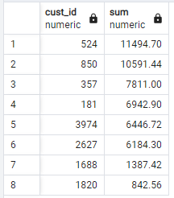
Group By
SELECT cu.cust_id, SUM(amount_sold)
FROM Sales s
INNER JOIN Customers cu on s.cust_id = cu.cust_id
INNER JOIN Countries co on cu.country_id = co.country_id
WHERE co.country_name = 'Canada'
GROUP BY cu.cust_id
ORDER BY SUM(amount_sold) desc;

Slide 83
Order of Execution
The SQL engine applies any WHERE clauses before GROUP BY clauses
When we apply the WHERE clause, none of the aggregate functions have yet been calculated
How do we deal with this?

Slide 84
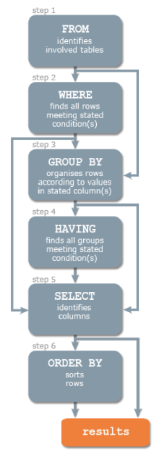
Order of Execution
The WHERE clause lets us filter out rows before our aggregate
functions are calculated
The HAVING clause lets us filter out rows after our aggregate
functions are calculated
We can filter on MAX, MIN, AVG, etc, using a HAVING clause
We can prevent rows from being counted in our aggregate functions using WHERE

Slide 85

The HAVING clause
SELECT cu.cust_id, SUM(amount_sold)
FROM Sales s
INNER JOIN Customers cu on s.cust_id = cu.cust_id
INNER JOIN Countries co on cu.country_id = co.country_id
WHERE co.country_name = 'Canada'
GROUP BY cu.cust_id
HAVING SUM(amount_sold) > 10000
ORDER BY SUM(amount_sold) desc;

Slide 86
Grouping by Date
Date column types are very flexible for grouping results
We can summarise results over years, months, days, or even minutes
We can use the EXTRACT function to extract the part of the date we are interested in.

Slide 87
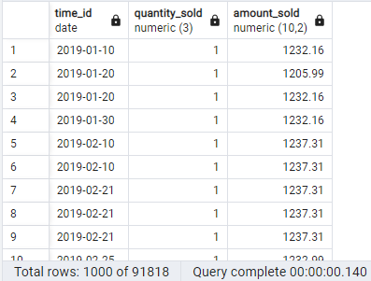
Grouping by Date
SELECT time_id, quantity_sold, amount_sold
FROM sales;

Slide 88
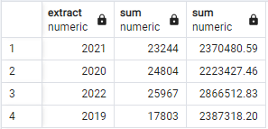
Grouping by Date
SELECT EXTRACT(year FROM time_id), SUM(quantity_sold), SUM(amount_sold)
FROM sales
GROUP BY EXTRACT(year FROM time_id)

Slide 89
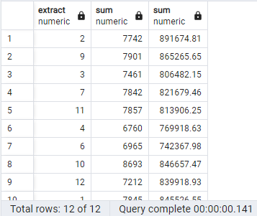
Grouping by Date
SELECT EXTRACT(month FROM time_id), SUM(quantity_sold), SUM(amount_sold)
FROM sales
GROUP BY EXTRACT(month FROM time_id)

Slide 90
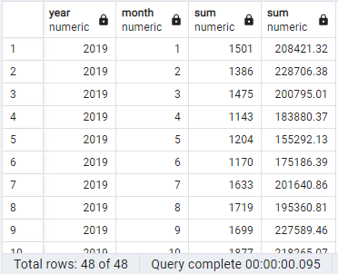
Grouping by Date
SELECT EXTRACT(year FROM time_id) "year",
EXTRACT(month FROM time_id) "month", SUM(quantity_sold),
SUM(amount_sold)
FROM sales
GROUP BY EXTRACT(year FROM time_id), EXTRACT(month FROM time_id)
ORDER BY EXTRACT(year FROM time_id), EXTRACT(month FROM time_id);

Slide 91
Summary
This has been a quick tour of SQL.
Comparison with R/Python
CRUD operations
Many to many relationships
Aggregate queries
Those completely new to it will need to do quite a bit more study.
DataCamp has an introduction to sql for data science

Slide 92

Lab
Complete the SQL Island game for a fun 😁 review of SQL in SQL Island
If you don’t speak German,
change the language in
“Sprache wechseln”
Please complete the other not so fun lab on Brightspace to review/practice SQL concepts.

Slide 93
Questions?

